Slide 1

CSE 214
Submitted By: Md Abdullah Al Mamun Emon
Id : 23701028
Submitted To : Dr. Abu Nowshed Chy
Assistant Professor, Computer Science & Engineering, University of Chittagong
September 2024

Slide 2
CSE 214
Submitted By: Md Abdullah Al Mamun Emon
Id : 23701028
Submitted To : Dr. Abu Nowshed Chy
Assistant Professor, Computer Science & Engineering, University of Chittagong
September 2024

Slide 3
CSE 214
Drawing and Data Visualization Lab
September 2024

Slide 4

Learning Roadmap
CSE 214
Step - 1
Step - 2
Step - 3
Matplotlib
Plotting
R Basics
Python Basics
Step - 6
Step – 5
Step – 4
ggplot2
Data Perfection
Data Manipulation

Slide 5
CSE 214
01
Purpose of Use
02
Plot
CONTENTS
For Each Plot
03
Source Code
04
Dataset

Slide 6


Why Do We Visualize Data?
Curious?
Too Much Data & Hard To Understand
Understanding Data
Making Decisions
Time Consuming & Risk of Error
Data
Visualization
Storytelling
Analyzing Patterns
Misleading Representation

Slide 7






Purpose of Use & Example :
Bar Plot | Matplotlib
Comparing Different Categories & Groups
Showing Differences in Magnitudes
Sales Comparison.
Population Growth.

Slide 8
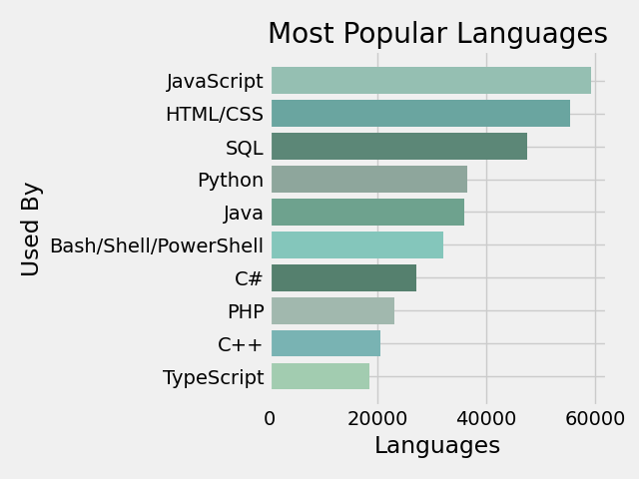




Popular Programming Language Visualization
Horizontal Bar Plot | Matplotlib
View Source Code
The Actual Code For This Plot
View Explanation
Readme With Explanation
View Dataset
Dataset of This Plot

Slide 9

Purpose of Use & Example :
Scatter Plot | Matplotlib
Establishing Correlations Between Two Items
Identifying Trends, Patterns & Outliers
Height Vs Weight
Sales Vs Growth

Slide 10
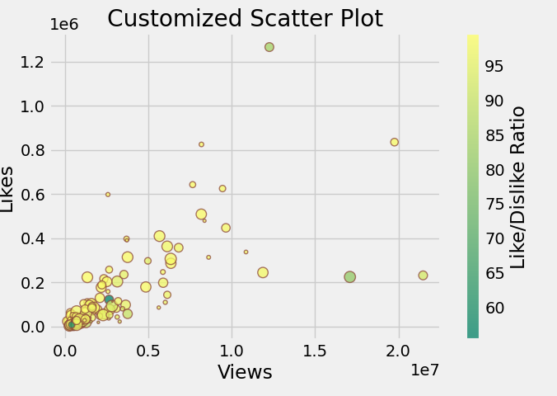
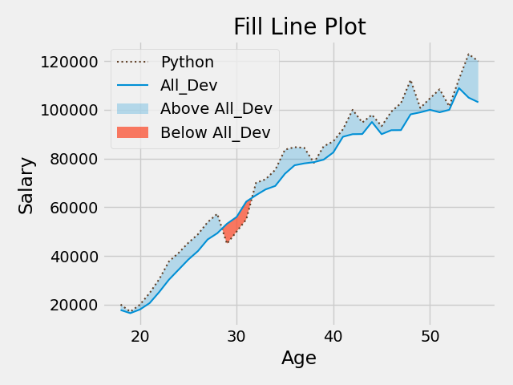
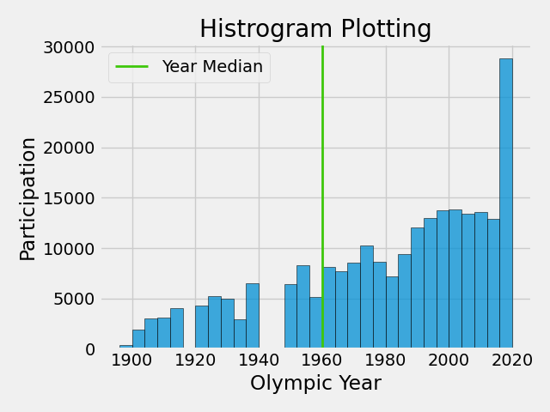
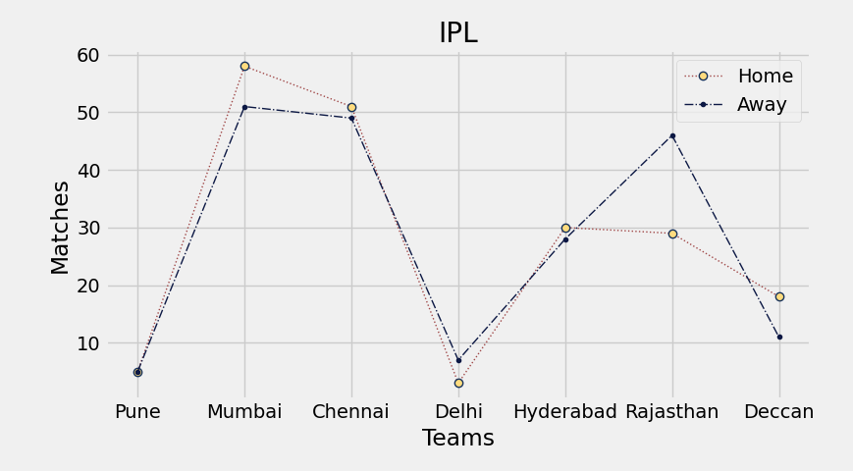
YouTube Like Ratio Visualization
Scatter Plot | Matplotlib
View Source Code
The Actual Code For This Plot
View Explanation
Readme With Explanation
View Dataset
Dataset of This Plot

Slide 11

Purpose of Use & Example :
Line Plot | Matplotlib
Showing Trends Over Time on Continuous Data
Tracking Changes Over Intervals
Stock Market Trends
Monthly Reports

Slide 12
IPL Home & Away Match Visualization
Line Plot | Matplotlib
View Source Code
The Actual Code For This Plot
View Explanation
Readme With Explanation
View Dataset
Dataset of This Plot

Slide 13

Purpose of Use & Example :
Pie Plot | Matplotlib
Visualizing Proportions & Percentages
Showing Parts of a Whole
Market Share
Budget Allocation

Slide 14
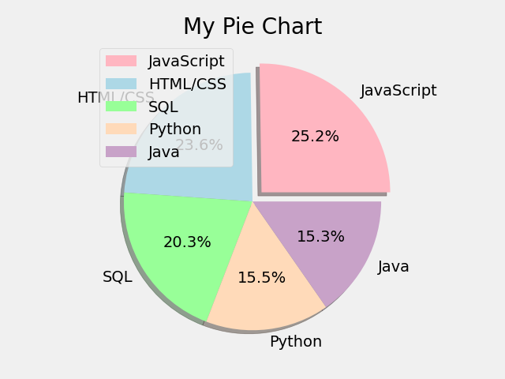
Most Used Languages Visualization
Pie Plot | Matplotlib
View Source Code
The Actual Code For This Plot
View Explanation
Readme With Explanation
View Dataset
Dataset of This Plot

Slide 15

Purpose of Use & Example :
Fill Line Plot | Matplotlib
Highlighting Values
Emphasizing Plot Parts
Minimum Wage Calculation
Comparing Wage

Slide 16
Python Developers Salary Visualization
Fill Line Plot | Matplotlib
View Source Code
The Actual Code For This Plot
View Explanation
Readme With Explanation
View Dataset
Dataset of This Plot

Slide 17

Purpose of Use & Example :
Stacked Plot | Matplotlib
Showing Cumulative Totals Over Variables Like Time
Emphasizing Volumes Under The Lines
Traffic Over Time
Cumulative Profit

Slide 18
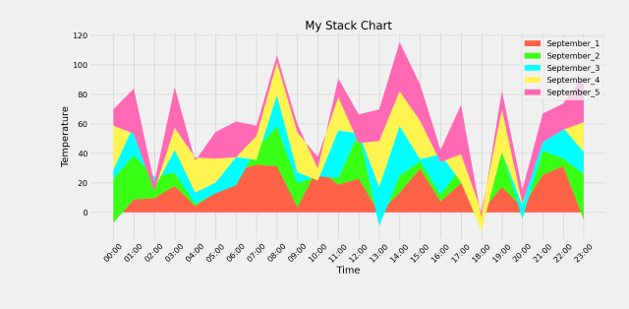
Temperature Data Visualization
Stacked Plot | Matplotlib
View Source Code
The Actual Code For This Plot
View Explanation
Readme With Explanation
View Dataset
Dataset of This Plot

Slide 19
Purpose of Use & Example :
Histogram Plot | Matplotlib
Showing Distribution
Of Numerical Data
Showing How Data is Spread or Grouped
Exam Score Distribution
Income Distribution

Slide 20
Olympics Participations Visualization
Histogram Plot | Matplotlib
View Source Code
The Actual Code For This Plot
View Explanation
Readme With Explanation
View Dataset
Dataset of This Plot

Slide 21

Purpose of Use & Example :
Sub Plot | Matplotlib
Visualizing Multiple Related Data
Providing Complexity & Contrast of Any Data
Comparing Growth of Different Species

Slide 22
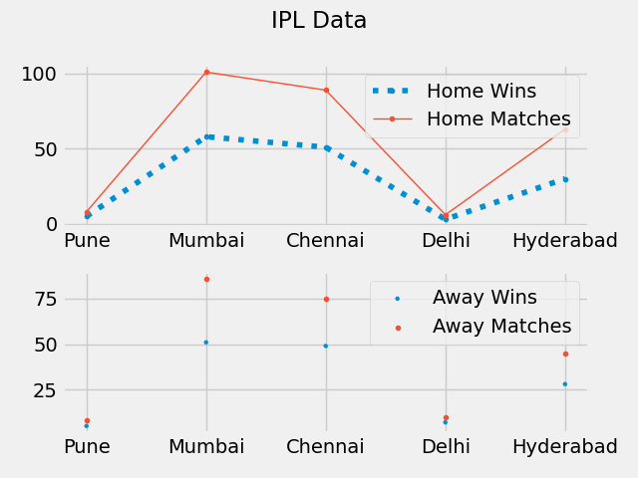
IPL Match Wins Visualization
Sub Plot | Matplotlib
View Source Code
The Actual Code For This Plot
View Explanation
Readme With Explanation
View Dataset
Dataset of This Plot

Slide 23
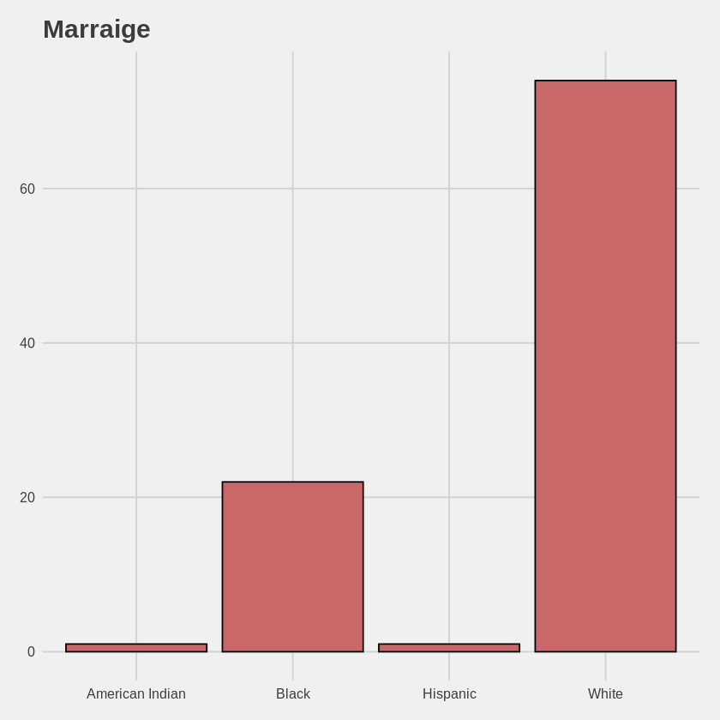


Marriage By Race Data Visualization
Bar Plot | R-ggplot
Source Code
Dataset

Slide 24
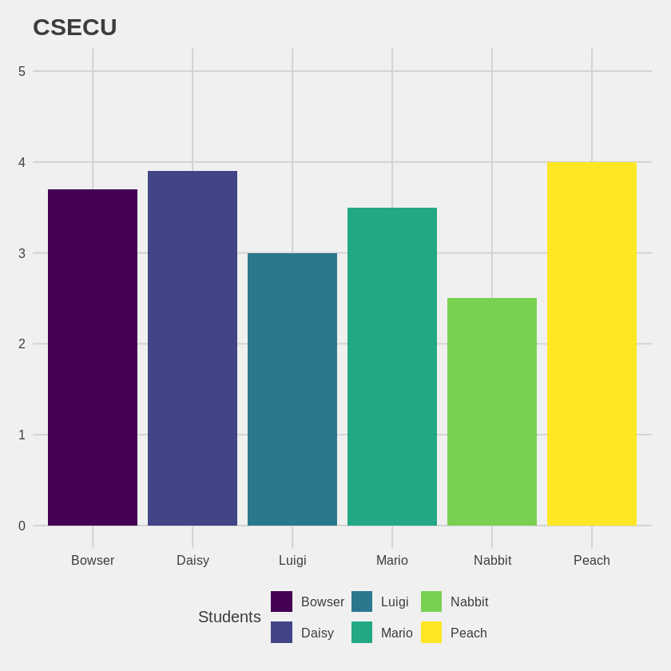
GPA Colorblind Visualization
Bar Plot | R-ggplot
Source Code
Dataset

Slide 25
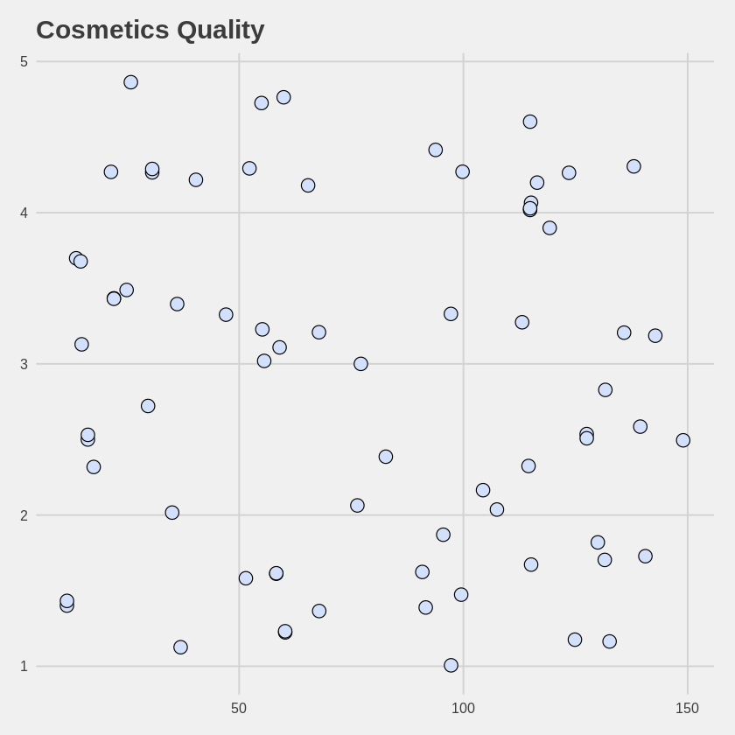
Cosmetics Rating By Price Visualization
Point Plot | R-ggplot
Source Code
Dataset

Slide 26
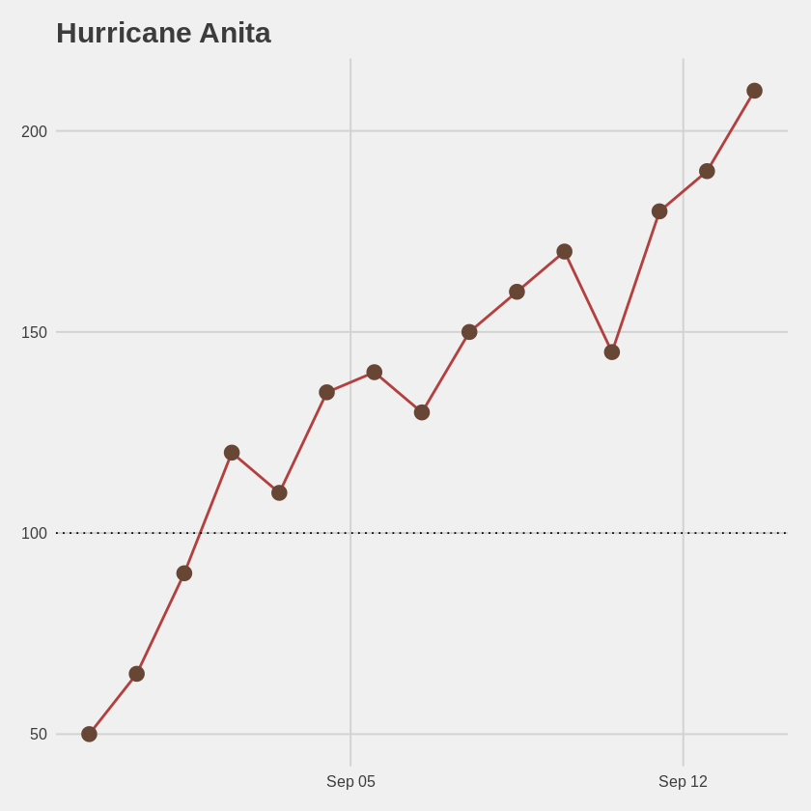
Speed of Wind Over Time Visualization
Point Plot | R-ggplot
Source Code
Dataset

Slide 27
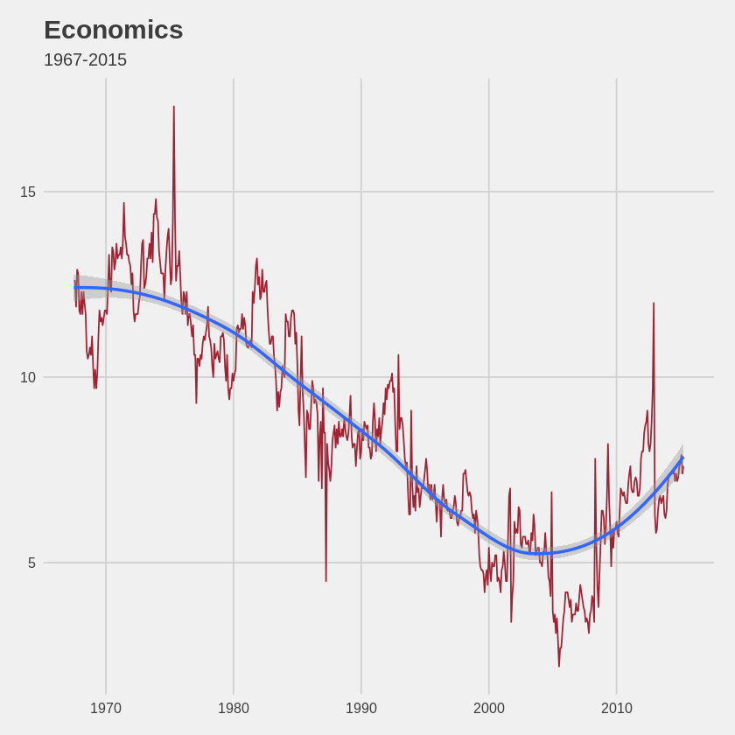
Personal Savings Rate Over Time Visualization
Time Series | R-ggplot
Source Code
Dataset

